Slide 1
Implementing a mandatory vaccination policy
Emma Incerti Zapedowski, Senior Advisor – Workplace Relations
Zora Marko – OH&S and Road Safety Education Manager
Megan O'Connell – Director, Member and Advocacy Solutions

Slide 2
Acknowledgment of Country
ELAA acknowledges the traditional owners of the land on which we live and work and pay our respects to Elders past, present and future.

Slide 3
Administration
PARTICIPANT AUDIO & VIDEO
Q&A FUNCTION – CHAT IS DISABLED
SESSION IS RECORDED
TIME AVAILABLE
TECHNOLOGICAL DISRUPTION

Slide 4
The Victorian Public Health Order (Pandemic Order)
Background:
During the COVID-19 pandemic, the Victorian Government introduced mandatory vaccinations for the early childhood education and care sector.
During 2020 and 2021, this was mandated through the State of Emergency and Directions from the Chief Health Officer.
In December 2021, the Victorian Government introduced its pandemic management framework which includes Pandemic Orders.
Each Pandemic Order is made by the Victorian Health Minister and is renewed on a three-month basis.
The current Pandemic (Workplace) Order No. 8 will be in place until 12 July 2022.
Refer to: Workplace Order | health.vic.gov.au.

Slide 5
If the Government mandate ends
There no longer exists a requirement for mandatory vaccinations for your staff, parent volunteers and Committee members.
If you choose to continue with mandatory vaccinations, an employer can choose to take steps to implement a policy.
You should aim to implement a policy before the government mandate is expected to end (12 July 2022).
Can consider special paid leave arrangements.
Implementing a vaccination requirement:
An employer can impose new obligations on employees during the employment relationship if the requirement is 'lawful and reasonable’
Vaccinations do not need to be in the original employment contract.

Slide 6
Methods for mandating vaccinations
Method 1: Government Mandate (may expire)
Government Public Health Order (Pandemic Order) which makes it a legal requirement to be vaccinated to enter the premises for the duration of the Order.
Creates a legal requirement for the employee to comply as part of the inherent requirement of the role.
Method 2: Employer implements a mandatory vaccination policy (consultation with staff required).
This makes it a lawful and reasonable employer direction.
This means:
A mandatory vaccination policy once consulted and agreed by staff will cover all existing employees.
Prospective employees will sign contracts of employment with a mandating clause (as a condition of accepting employment).

Slide 7
What are your options?
Option A: Take no action
Vic Government Public Health Order (Pandemic Order) expires.
Option B:
Implement a mandatory vaccination policy (after consultation with staff and their representatives).
The employer is then responsible as it a lawful and reasonable direction for the duration the policy is in effect.
Option C: Implement a voluntary policy (requires consultation).
This is an employer policy that strongly recommends but does not mandate COVID-19 vaccinations in the workplace.
This means that unvaccinated staff will be permitted to return to work.
ELAA has a template policy available for members.
There is no right or wrong way. It is entirely the decision to make a proposal to staff by your Committee/management team. ELAA will not advise you of the decision to take.
When making your proposal, it is important to consider what is best for the needs of your staff, children and families.

Slide 8
What this means for you
Option A: Government mandate ends and no action is taken
Unvaccinated employees who have been stood down or on LWOP must be allowed to return to their substantive (old) roles and contracted hours with immediate effect. Consultation may be required.
Unvaccinated employees who are on personal/carer’s leave will remain on the duration of their leave as determined by medical advice (medical certificates). A medical clearance to return to work (fit to work) may be required.
Employees who are on long service leave (LSL) or annual leave will remain on the specified/agreed period of leave.
There is no requirement to rehire an employee who has been lawfully terminated (dismissed) during the government mandate.
Update and review relevant policies (i.e. Infectious Diseases Policy/Illness Policy).

Slide 9
Option B: Implement a mandatory vaccination policy
What is a mandatory vaccination policy?
A lawful and reasonable direction for your employees to be vaccinated against COVID-19.
Can apply to:
employees directly employed by the employer;
(Optional) agency staff, visitors, CoM, volunteers and contractors.
ELAA’s policy template has been developed to mirror the current Pandemic (Workplace) Orders in effect by the Victorian Government.
Special paid leave may need to be considered for unvaccinated employees if there is a gap between the government mandate and the enactment of your policy.

Slide 10
Option C: Introduce a voluntary policy
May be used by ECEC services who do not wish to mandate vaccines by want to strongly recommend it.
As a voluntary policy, it can be used to demonstrate the employer’s position.
Does not constitute a lawful and reasonable direction.
Staff cannot be prevented from attending the workplace unvaccinated and must be permitted to return to work
Should be a standalone policy.
Consider implications on other existing policies (i.e., Infectious Diseases or Illnesses Policy).
Consider if this is an effective option.

Slide 11
Factors to consider with implementing your mandatory vaccination policy

Slide 12
When can an employer require an employee to be vaccinated?
Employers/Committees can only require their teachers and educators to be vaccinated where:
a specific law (such as a state or territory public health order) requires it
it is permitted by an enterprise agreement, other registered agreement or employment contract, or
The employer implements a COVID-19 vaccination policy - is providing existing employees with a lawful and reasonable direction to be vaccinated.

Slide 13
What is a lawful and reasonable direction
An employer may still be able to give their employee a lawful and reasonable direction to get vaccinated in the form of a policy.
A direction is lawful if it complies with:
Any employment contract, award or agreement terms.
Commonwealth, state or territory law that applies (for example, an anti-discrimination law).
For a direction to be reasonable:
Depends on the facts of the individual situation and needs to be assessed on a case-by-case employee basis.
There is a range of factors that may be relevant when determining whether a direction for an employee to be vaccinated against COVID-19 is reasonable.

Slide 14
Factors to determine reasonableness:
the nature of each workplace (are there vulnerable persons?)
the tier of work the employee performs (see Tier system)
the extent of community transmission of COVID-19 in the location
the effectiveness of vaccines in reducing serious illness
the availability and effectiveness of other control measures in the workplace (for example, physical distancing, limitations on visitors, ventilation, mask-wearing and testing)
each employee’s circumstances, including their duties and the risks associated with their work
whether employees have a legitimate reason for not being vaccinated (for example, a medical reason)
the availability of vaccines.

Slide 15
Tiers of work – Fair Work Ombudsman advice
Tier 1 work – likely to be reasonable
Tier 2 work – likely to be reasonable
Tier 3 work – depends on the levels of community transmission
Tier 4 work – unlikely to be reasonable (not recommended)
Required as part of their duties to interact with people with an increased risk of being infected with COVID-19 (for example, employees working in quarantine or border control).
Required to have close contact with people who are particularly vulnerable to the health impacts of COVID-19 (for example, employees working in health care, early childhood or aged care).
Likely interaction between employees and other people such as customers, other employees or the public in the normal course of employment (e.g., retail).
Minimal face-to-face interaction as part of their normal employment duties (for example, where they are working from home) (e.g., office workers).

Slide 16
Your consultation obligations

Slide 17
Consultation requirements
Mandatory vaccination affects worker health and safety.
This invokes consultation obligations under the Victorian Occupational Health and Safety Act 2004 (OH&S Act).
Consultation obligations may also apply under relevant enterprise agreements (EBA) and awards.
An employer must so far as is reasonably practicable consult with their employees who are likely to be affected by the proposed change.
Consultation involves:
sharing information with employees about the matter
giving employees a reasonable opportunity to express views
taking those views into account.
This must be done at a stage where the employees can still influence the outcome.

Slide 18
Step 1: Meet with your Committee/management team to decide your approach
During this meeting, we recommend you:
Plan the best method to consult with all staff
Review the ELAA Mandatory Vaccination Policy and amend it as needed.
Do not make a final decision at this stage or vote on the policy.
You ideally need a policy in place before the Government mandate may expire on 12 July 2022.
Factors to consider:
Are you going to require two doses or booster vaccinations?
How will you manage exemptions?
Will the policy apply to parent volunteers, relief staff and contractors as well as employees?
What about prospective employees? Will you change your contract templates to include a mandatory vaccination clause? (ELAA can assist).

Slide 19
Example planning (guide only)
Suggested timeframes | Action | Who is responsible
Week of 6th of June | Committee/Management team meets to discuss proposed plan | Executive CoM/ Management team
Week of 6th of June/ Week of 13th of June | Develop risk assessment | Executive CoM and/or key staff members. (e.g. Director/Nominated Supervisor/HR, OH&S Representatives).
Week of 13th of June | All staff consultation meeting is held. | President Staffing/HR team to send an email outlining the proposal.
Week of 20th of June | Hold follow up individual meetings Zoom meetings with absent staff, (if required) | CoM
Week of 11th of July (on or after 12^{th) `} | CoM to vote on policy Leadership team to confirm policy. | Executive CoM/ Management team

Slide 20
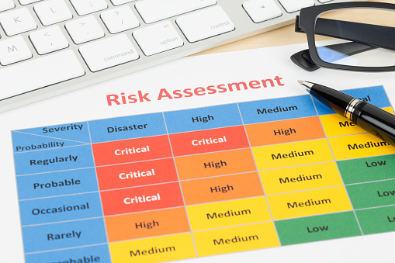
Step 2: Review your COVID-19 risk assessment to include mandatory vaccinations
A risk assessment will assist to:
identify which workers, children and families are at risk of exposure to the hazard (i.e., COVID-19)
determine what sources and processes are causing the risk
identify if and what kind of control measures should be implemented (i.e. mandatory vaccinations), and
check the effectiveness of existing control measures.
You will need to review your risk assessment if something new becomes known or if there is a failure in your control measures (e.g. another COVID-19 outbreak at the service).

Slide 21
Step 3: Begin consultation with staff
Prior to the meeting:
Outline in writing to staff your proposed change (email is sufficient).
Attach a copy of your draft mandatory vaccination policy and the risk assessment.
During the consultation meeting you will:
Explain the reason for your proposal.
Provide an opportunity for staff to present their views (e.g. in the staff meeting or in individually in follow up meetings)
Consult with staff about the risk assessment and risk factors.
Explain alternative control measures available and their effectiveness (hierarchy of controls).
Explain how you intend to manage exemptions and protect staff privacy.
If you have a high number of objections, consider if your alternative control measures will be sufficient to meet your OH&S obligations.

Slide 22
Holding follow up individual meetings (as needed)
Individual consultation meetings via Zoom/Teams can be used for the following purposes:
Consult with staff members who were unable to attend your staff meeting.
Consult with staff members who are absent on leave (including parental leave).
Consult with unvaccinated workers who are on leave without pay.
During these meetings, it is essential to:
Provide a copy of your draft mandatory vaccination policy and risk assessment.
Allow staff to provide their views.
Meet with any Health and Safety Representatives and union representatives (if requested).
It must be a confidential meeting to discuss concerns raised (with the opportunity to bring a support person/representative).

Slide 23
Step 4: Take staff feedback into account
Before your Committee/management team meets again, it is essential that staff feedback is taken into account before you implement your decision.
This may involve:
Documenting any concerns raised in your consultation process.
Re-reviewing your risk assessment. Does it support a mandatory vaccination policy?
Consider:
Do you need to offer special paid leave to unvaccinated employees during any consultation period?
Have you fully consulted with all staff? A policy may be reasonable but may be challenged on grounds the consultation was insufficient.
See: Construction, Forestry, Maritime, Mining and Energy Union, Mr Matthew Howard v Mt Arthur Coal Pty Ltd T/A Mt Arthur Coal (C2021/7023) (link) (the BHP case).

Slide 24
Step 5: Make your decision and implement the policy
This will involve:
Conduct a final review of your tailored mandatory vaccination policy.
Committee of Management voting on the policy in accordance with your service’s processes.
Endorse the policy in your leadership team/board.
Determine review intervals as required (recommend 3-6 months).
Determine when your policy will take effect.
Confirm when and how you will notify parents, families and staff.

Slide 25
Developing your risk assessment
Presented by Zora Marko
OH&S and Road Safety Education Manager

Slide 26
Safe working environment
Under the Victorian OHS Act employers must:
Where a risk is identified, employers must eliminate the risk, so far as is reasonably practicable.
When elimination is not possible, reduce the risk so far as reasonably practicable through control measures.
Consider the impact on children (your obligations to all persons attending your premises).
Sample risk assessments:
ACECQA Risk Assessment and Management Tool. Risk-Assessment-and-Management-Tool-RAM.pdf (childaustralia.org.au)
Safe Work Australia. Template and example COVID-19 risk register | Safe Work Australia (swa.gov.au)

Slide 27
Is it reasonably practicable?
To determine whether to eliminate or minimise a risk is ‘reasonably practicable’ in the circumstances.
You must consider:
the likelihood and degree of harm of the hazard or risk,
the reduction in the likelihood and/or degree of harm that will result if the control measure is adopted, and
the available ways of eliminating or minimising the risk.
The more likely the hazard or risk, or the greater the harm that may result from it, the less weight should be given to the costs of eliminating the hazard or risk.
Notes:
Sample risk assessments:
Safe Work Australia. Template and example COVID-19 risk register | Safe Work Australia (swa.gov.au)
ACECQA Risk Assessment and Management Tool. Risk-Assessment-and-Management-Tool-RAM.pdf (childaustralia.org.au)

Slide 28
ACECQA Risk Management Tool
ACECQA Risk Assessment Management Tool

Slide 29
Risk Assessment and Management Cycle

Slide 30
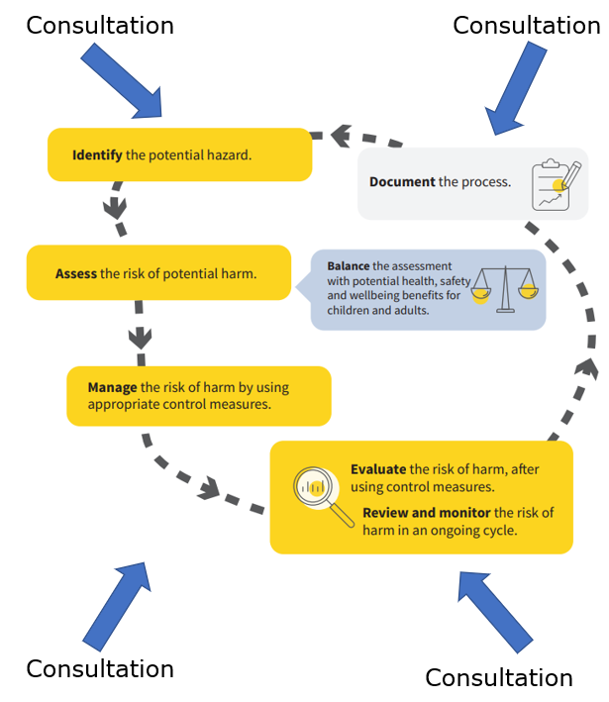
Role of consultation in a risk assessment

Slide 31
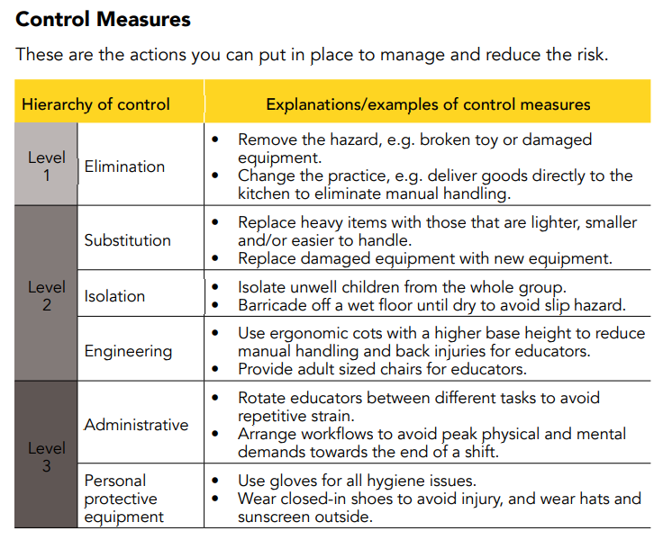
Hierarchy of Control

Slide 32
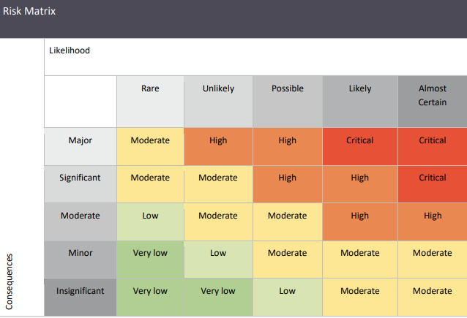
Using a Risk Matrix in your Risk Assessment

Slide 33
Sample risk assessment (simplified)
Service setting (affected persons) | Activities | Tier Level | Hazard (COVID-19) Risk Rating | What controls the risk?
Teachers and educators | Working in direct contact with children/families. | Tier 2 | High | Mask wearing, RATs, hygiene, social distancing.
Administration staff on premises. | Working in the office, sometimes in contact with children. | Tier 3 | High | As above
Head office staff (e.g. IT, People and Culture etc.) | No or minimal contact with children. | Tier 4 | Moderate | As above
Children/families | Attending the premises | Tier 2 | High – vulnerable children attending. | As above

Slide 34
Final considerations

Slide 35
Exceptions to a vaccination requirement
A policy is more likely to be considered reasonable if it has a transparent exception application process.
Exceptions to your policy should be consistently interpreted and applied equally.
How do you intend to manage medical exemptions? Will you accept medical certificates (recommended)? Protection on account of a temporary illness/injury.
Staff who don’t want to be vaccinated on religious grounds? Consider anti-discrimination legislation.
Staff who are pregnant/ breastfeeding or have pregnancy intentions? A protected attribute.
Employees who have anti-vaccination political views? Not a protected attribute.
Can the employee reasonably work from home instead? (important for administrative staff).
Notes:
The Fair Work Commission/Courts have indicated that an umbrella approach without consideration for particular employee circumstances (and an ability to apply for exemptions) may not be considered reasonable.
In considering whether to impose a mandatory vaccination requirement, some key factors are likely to include:
the likelihood of staff being exposed to COVID-19 in the workplace, taking into account the nature of the role(s) undertaken by staff, the particular features of the workplace and the rates of COVID-19 infections and transmission in the community;
the degree of harm that might result from exposure to COVID-19 (including consideration of any particular vulnerabilities of staff) and the extent to which unvaccinated staff pose a risk to others;
whether vaccination is an effective control measure against those risks (so far as is reasonably practicable), based on the current medical evidence on the efficacy of the particular COVID-19 vaccine in both preventing infection and transmission;
the availability and suitability of other control measures to eliminate or reduce the risk of exposure to COVID-19; and
whether it is appropriate to include any exemptions for particular classes of staff (noting that there were no exemptions made in Glover) and if so, how they will be accommodated given any associated risks.
Additionally, employers should consider whether a mandatory vaccination requirement gives rise to any implications under anti-discrimination legislation. Victorian public sector employers should also consider any implications under the Charter of Human Rights and Responsibilities Act 2006 (Vic).
What Are the Consequences for Breaching the General Protections?
Unlike unfair dismissal claims, a court can also impose a penalty against you in a general protections claim. The penalty will vary depending on the severity of the breach, but it can be up to $63,000 per breach for a corporation or up to $12,600 per breach for an individual. This penalty is in addition to any compensation that you need to pay.

Slide 36
Working from home
Consider whether based on the staff member’s current duties/job description they can reasonably continue to work from home.
Requires an individual assessment of circumstances and the work location listed in their contract.
Employer can direct employees to return to the workplace (consider if they can reasonably perform their duties from home, and have been to date).
Key cases (Fair Work Commission):
Karen O’Toole v Australian Community Support Organisation Ltd (2022) FWC 477. Ability to continue working from home.
Ursula Bernadette Gee v Eastern Health (2022) FWC 932. The employee requested to work from home indefinitely.
Notes:
Vaccination related matters | Fair Work Commission (fwc.gov.au)
O’Toole v Australian Community Support Organisation Ltd [2022] FWC 477 (Masson DP, 3 March 2022).
The employee was a Family and Carer Program Worker. The Victorian Government introduced a public health direction that required the employer to ensure workers who had not been vaccinated against COVID-19 did not attend its facility unless they had a valid medical exemption.
The employee told the employer she was unvaccinated but did not need to attend the facility because she could perform her role from home.
Face-to-face service delivery remained a feature of the employee’s role during the pandemic. The Commission decided that the employer was entitled to require the employee to carry out the full requirements of her role which included attending the employer’s facility. The employer had a valid reason to dismiss the employee because the employee could not lawfully attend the employer’s facility.
The Commission decided that the employee's dismissal was not harsh, unjust or unreasonable. Before she was dismissed, the employee was given opportunities to respond to the employer’s concerns about her unvaccinated status and at each opportunity she confirmed she was undecided and would not be getting vaccinated within the required timeframe.
Gee v Eastern Health (Wilson C, 22 April 2022)
The employee was a project officer for a health provider. The employer said that in March 2020, employees were offered the option to work from home if they could. This was a temporary arrangement caused by the COVID-19 pandemic.
In 2021, the Victorian Government introduced a public health direction that required the employer to ensure its staff were vaccinated against COVID-19 unless they had a valid medical exemption, before it allowed them to enter the employer’s healthcare facility.
The employee said that she did not intend to be vaccinated and asked to work from home indefinitely. She argued that it would be reasonable and practical because her role was administrative and had no client face-to-face contact. The employer said that working from home permanently was not sustainable and that vaccination was an inherent requirement of employment for all staff unless they were exempt.
The Commission did not accept the employee’s argument that her employment contract had been changed to allow her to work from home permanently if she chose. That would be counter-intuitive because in-person interactions with patients and staff would always be necessary for the employer, who was a major public health authority.
The Commission concluded that the employer had a valid reason to dismiss the employee because she could not fulfil the inherent requirements of her job without providing her vaccination information. Before she was dismissed, the employee was notified that her dismissal was contemplated and what she had to do to avoid dismissal.

Slide 37
Managing non-compliance
Employers may commence disciplinary action where a staff member fails to comply with a lawful and reasonable direction – contact ELAA.
Further opportunities to provide acceptable certification for a medical/other exemption should first be provided.
Legal risks to consider:
Unfair dismissal claims
General protections (adverse action claims)
Discrimination claim
Breach of contract
Key cases (Fair Work Commission):
Barber v Goodstart Early Learning (2021) FWC 2156. The employer’s vaccination requirement was a lawful and reasonable direction (without a government mandate).
Maria Corazon Glover v Ozcare (2021) FWC 2989. Failure to follow a lawful and reasonable direction (immunisation policy) was a valid reason for dismissal.
Notes:
Explanatory articles:
Barber v Goodstart – can employers now mandate vaccinations in the workplace? | Gadens
Employees’ Dismissals for Vaccine Refusal Not Unfair – Ms Bou-Jamie Barber v Goodstart Early Learning and Jennifer Kimber v Sapphire Coast Community Aged Care - HR Legal

Slide 38
Staff refusing to work with unvaccinated co-workers?
Unlikely that an employee can refuse to attend their workplace because a co-worker isn’t vaccinated against COVID-19.
The reasons for this include that the co-worker may have a legitimate reason not to be vaccinated (a medical reason) or not all workplaces require mandatory vaccinations.
Consider if a vulnerable person is a member of staff or a child attending the service as this will influence your risk assessment.
What can an employer/Committee do if an employee refuses to attend?
Can direct them to attend the workplace if the direction is lawful and reasonable.
Detail the steps they’ve taken to ensure a safe workplace (e.g., COVID-19 safe plan, risk assessment, other control measures).

Slide 39
What about new employees?
You can impose a vaccination requirement on prospective employees as a condition of employment (in an employment contract).
Committees/employers should consider their obligations and responsibilities carefully, for example, under anti-discrimination laws.
Important to provide a clear process for submitting exemptions.
During the recruitment process:
inform the prospective employee the organisation/service has a mandatory vaccination requirement (including in your job advertisement).
provide a copy of the policy
do not ask for particulars about the employee’s circumstances or reason for exemption.
Updated contract templates are available for download in the ECMM v.3 – updated in 2022.

Slide 40
How to download your mandatory vaccination policy
ELAA has a free policy now available for download for members.
For existing PolicyWorks subscribers, the policy can be accessed in your MyMembership Portal.
For ELAA members who do not have a PolicyWorks subscription, please email us at membersolutions@elaa.org.au.

Slide 41
Next steps
If you are choosing option A:
Unvaccinated employees who:
have been stood down or on LWOP must be allowed to return to their substantive (old) roles and contracted hours with immediate effect. Contact ELAA for further advice as it may involve consultation/redundancy.
are on personal/carer’s leave will remain on the duration of their leave as determined by medical advice (medical certificate).
on long service leave (LSL) or annual leave will remain on the specified/agreed period of leave.
have been lawfully terminated (dismissed) during the government mandate and are not required to be rehired.

Slide 42
If you have chosen option B (or C):
Download copy of the ELAA Mandatory Vaccination Policy from PolicyWorks. Tailor it to meet your service/organisation’s requirements.
Hold your Committee/management meeting to plan and review your options (as per slide 7).
Undertake the OH&S risk assessment.
Commence your consultation with staff and their representatives before the end of term 2 (or as soon as practicable).
Endorse your new mandatory or voluntary vaccination policy (on or after 12 July 2022).
Use the updated ELAA contract templates. Available in the ELAA Early Childhood Management Manual (ECMM) 2019 v.3.

Slide 43
Questions:
Please write any questions using the Q&A function at the bottom of your screen.
Useful links:
Fair Work Ombudsman. COVID-19 vaccinations: workplace rights and obligations. https://coronavirus.fairwork.gov.au/
ACECQA. Risk Assessment and Management Tool. Risk-Assessment-and-Management-Tool-RAM.pdf (childaustralia.org.au)
Safe Work Australia. Information for early childhood risk assessments. https://covid19.swa.gov.au/covid-19-information-workplaces/
WorkSafe. Position on ‘reasonably practicable’. https://content.api.worksafe.vic.gov.au/sites/default/files/2018-06/ISBN-Reasonably-practicable-how-WorkSafe-applies-the-law-2007-11.pdf
Fair Work Commission. Vaccination related matters (case law). https://www.fwc.gov.au/benchbook/vaccination-related-matters

Slide 44
Thank you for attending
We are here to support you.
Email us: membersolutions@elaa.org.au
Call us on 03 9489 3500 (press 2) 10 am – 3 pm, Monday to Friday.
Know someone who is interested in becoming an ELAA Member?
ELAA full and subscriber members can contact us for advice on:
Industrial relations
Human resource management
Occupational health and safety
Road Safety Education
Policy and advice
Professional Development and much more.
Contact our Memberships team at memberships@elaa.org.au or call us on
(03) 9489 3500.

