Slide 1

Ending the year on a high: Planning your AGM and successful handover to the new committee
Term 3 2022
Notes:
Welcome to this evening’s session – Ending the year on high: Planning your AGM and successful handover to the new committee
My name is Emma Incerti-Zapedowski and I am joined by my colleague ______
Thank you for taking time out of your evening to join us for this session. Before we get started, I would like to Acknowledge the land on which we are meeting on tonight.

Slide 2

Acknowledgement of Country
Heart image is from Indigemoji, Australia’s first set of Indigenous emojis made on Arrente land in Mparntwe (Alice Springs)
Sourced from Indigemoji page on LinkedIn/June 2021/Sharon Rogers user
Notes:
Acknowledgement of Country
I would like to acknowledge the traditional custodians of the lands on which we all meet –
Tonight we are n the lands of the Wurundjeri people of the Kulin nation. I also acknowledge the Traditional Owners and Custodians of the various lands on which we are all meeting across Metro and regional Victoria for this webinar.
I pay my respects to elders past and present I would also like to extend my respect to any Aboriginal and Torres Strait people joining us for this session.
At ELAA we acknowledge the strong and continuous connection to the country held by First Nations people across Victoria and Australia.

Slide 3








Administration
TIME AVAILABLE
PARTICIPANT AUDIO & VIDEO
CHAT FACILITY
POLLS DURING PRESENTATION
COMFORT BREAKS
TECHNOLOGICAL DISRUPTION
EVALUATION
Notes:
As I said, my name is Emma and I am the Senior Workplace Relations Advisor at ELAA. I am joined by my colleague, Katrina.
Before we begin this presentation, there are just a few administration items we would like to go through.
Understanding your audience – welcome to share in chat
We have a large attendance this evening – glad you could all join us
This may be your first AGM & HO
Those who have been on a kindergarten committee
Those who have been on a committee other than a kindergarten committee
Anyone from a EYM managed kindergarten (be aware that some of the information in this presentation may not be relevant to your situation)
Presidents, Vice Presidents, Treasurers, Secretaries, general members, other?
Structure and time constraints – This Webinar will incorporate a presentation with some set time for questions and answers at the end of TOPIC 2 and at the end. It is fairly fast paced.
Participant video & Audio – Participant video & audio is disabled during the presentation, to ensure that everyone receives the information with minimal technical interruptions. Once the formal presentation has completed we will enable audio during Q & A session at for you to ask questions verbally. During Q & A, please ensure you are on mute unless speaking.
Use chat bar for questions during presentation – there will be two functions enabled for you to interact with us during the presentation. You will see that there is both a chat bar to enable you to comment and a Q & A bar for any questions you have regarding the presentation content. Both of these will be monitored and responded to as we can.
The Moderator has pasted the links to the Resource and Quick Reference Guide in the chat line.
ELAA will also collate the questions and provide answers to any question that we are not able to get to.
Polls during the presentation – throughout the presentation there will also be polls for you to answer. These polls will be short questions and your participation is voluntary.
Technical issues – If you are having technical issues throughout the presentation please use the chat bar for assistance and if one of the facilitators drops out the other one will take over.
Breaks, health and safety – during the presentation if you would like to take a break, make a coffee/tea and keep listening please feel free to do so.
Link to evaluation – At the end of the Webinar there will be a link to an evaluation survey for this presentation. We would greatly appreciate it this being completed.
Finally : This session is not recorded however we will be making the slides available. Also, please complete the online learning modules if you have not already done so.

Slide 4

This session
Who is Early Learning Association Australia (ELAA)
The Annual General Meeting (AGM)
  constitutional requirements
  committee recruitment
  planning the meeting
  preparing the agenda and reports
  election of the committee
The Handover:
  preparation
  essential information to pass on
  the meeting
Notes:
Key messages
This in one of a few sessions ELAA runs in conjunction with DET. ELAA also offers training on the following topics “Governance information”, “Employee Management and Development” and “Financial management” – some information does cross over with each of the other topics, but attending each of the sessions can provide you a great overview of the many hats you were managing a children’s education and care service
ELAA thanks DET for funding these sessions so we can support Committees and service leaders with managing these complex responsibilities
This session aims to increase your understanding of the requirements when planning and conducting your Annual General Meeting to ensure sound governance and a successful smooth transition from the current committee to the new committee.
Succession planning in the handover notes. For example the importance of documenting the events/tasks/projects etc throughout the year.

Slide 5
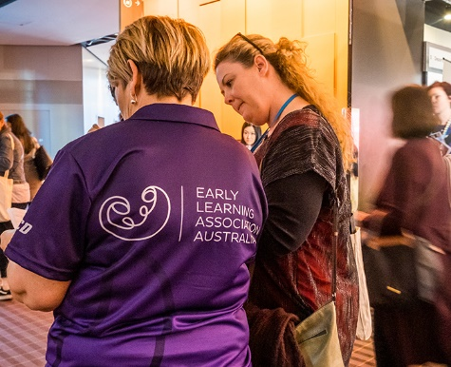
Who is ELAA?
A not for profit, incorporated association governed by a board
A membership organisation
  Training, employer representation, advisory service to early childhood committees of management, early years managers & local government
  Peak body (advocacy) championing for excellence in early learning for children across Australia and supports parents and service providers
  OHS, Road Safety Education and 3YO Kindergarten Expansion Projects
  “Learning Brought to Life” Professional Learning and Development program for all audiences
  Participation in early childhood events and forums
Notes:
ELAA is a not-for-profit, incorporated association governed by a board.
We are an organisation that supports our members and the wider sector manage their early childhood service and have been doing so for the last 30 years
We are a member organisation, and we engage in
-Training, representation, support and advisory service to early childhood committees of management, early years managers & local government. Our member solutions team provides advice via the phone or email but we are not a regulatory body
We are a Peak body championing for excellence in early learning for children across Australia and supports parents and service providers
We have a Road Safety Education program and offer OHS training and inspections.
We are also activitly involved in DET’s 3YO Kindergarten Expansion Projects
ELAA’s professional development program called “Learning Brought to Life” provides professional development for a range of audiences. Please visit the ELAA website for more information
ELAA also participates in early childhood events and forums

Slide 6
Links to the National Quality Standards
Area 7 – Governance and Leadership
Standard 7.1 Governance supports the operation of a quality service
  Element 7.1.2 Systems are in place to manage risk and enable the effective management and operation of a quality service.
  Element 7.1.3 Roles and responsibilities are clearly defined and understood and support effective decision making and operation of the service.
Standard 7.2 Effective leadership builds and promotes a positive organisational culture and professional learning community.
  Element 7.2.1 There is an effective self-assessment and quality improvement process in place.
N.Q.S.
Notes:
Key messages
Content in this presentation is aligned to Quality Area 7 of the National Quality Standards.
We have aligned the content to the elements 7.1.2, 7.1.3 and 7.2.1
ELAA encourage services to include tonight's attendance in the services QIP, under QA7. This shows DET the commitment AP have to continuous improvement with governance practices within the service.

Slide 7

Holding a successful Annual General Meeting (AGM)
Notes:
Key messages
Preparation is the key to success
No planning can lead to risks

Slide 8
Annual General Meetings
All Incorporated Associations must hold an AGM
Why
    Constitutional requirement – Associations Incorporation Reform Act 2012
    To inform their members about what they have been doing for the last 12 months
    To accept and confirm the financial report of the previous financial year
    To elect the new committee
When
  Within 5 months of the end of your financial year (constitution may state sooner)
Element 7.1.2 Systems are in place to manage risk and enable
the effective management and operation of a quality service.
Notes:
Key messages
Understanding legal requirements according to your constitution, having clear documented planning, running well managed meetings and preparing an effective handover process are all indicators of quality governance and leadership.
ALL meetings must meet COVIDSafe Settings. Government directives can and do change often, important to plan the AGM in advance, safest option is via online platform - https://www.coronavirus.vic.gov.au/coronavirus-covidsafe-settings
-use a teleconference, videoconference or other means of electronic communication
The Associations Incorporation Reform Act 2012 (the Act) permits members to take part in general meetings by using technology that allows members to clearly and simultaneously communicate with each other. The Act also permits meetings of the committee of an incorporated association to be conducted by use of technology that allows members to clearly and simultaneously communicate with each other.
Free video conferencing tools:
Zoom – up to 100 individuals for up to 40 mins (free subscription – more options for paid subscription)
Skype – up to 50 individuals
Video & voice calling with instant text communication
Slack
Microsoft teams
GoToWebinar For larger groups and more control over participation, as well as more record keeping, chat recording and data collection tools
Most people have become pretty savvy and comfortable with the use of technology during the last 20 months of lockdown so running an online AGM will be successful.
What about people who don’t have Internet access?
If your membership is not online or really isn’t technology literate, you may offer the alternative of proxy voting by mail. Make sure you allow a decent amount of time for people to receive their papers and respond to them.
You must use a standard form to proxy vote if the rules of the incorporated association require you to do so. A person acting as a proxy must act honestly and in good faith and exercise due care and diligence.
If you cannot run your AGM via online platform or there is a delay completing your financial statement in time due to COVID19, you can postpone the AGM.
The application form to request extension is still available through CAV.
In Folder:
Consumer Affairs: apply for an extension of time to hold the AGM. The Registrar is currently granting three-month extensions and waiving the usual fee. To seek an extension, complete our Extension of time to hold an AGM or lodge financial statements form (Word, 97 KB) and send it to cav.registration@justice.vic.gov.au.
the ACNC has advised that AGMs of registered charities can be postponed if they can’t be conducted safely and they will not take action unless there is evidence of wider non-compliance. Flowchart in folder.
CHO directive the EC sector be mandatory vaccinated, this requirement extends to CoM as you are volunteers of the service. If you choose not to get vaccinated, that doesn’t automatically mean you cannot continue to sit on the CoM. But what that means is you cannot be on the premises from October 18th and all of your involvement will be remotely, including all meetings via online platform. More information about the CHO directive will be available in the Forum being held tomorrow night, Sage will include the link in the chat for your reference.

Slide 9

First thing first….locate your constitution!
Provides key information about
- membership
- financial year
- notifications & advertising
- committee structure
- election process
- meeting proceedings
e.g. quorum & voting
- term of office
Notes:
Key messages
Ask Participants to refer to their constitution. Participants should check their financial year and any information that relates to the timing of the AGM.
Key information includes:
Definition of membership
Financial year date (Annual General Meetings must be held within 5 months of the end of the financial year)
Notification and advertising of your Annual General Meeting
Who can attend the meeting, i.e. members of the Association
Required quorum and the procedure to follow if the quorum is not met
Make up of the committee, i.e. number of members including office bearers and any specific roles
Term of office to determine when the newly elected committee officially takes over e.g. on the night or on the date specified in the constitution.
Check constitution for ruling which allows use of technology, proxies. (option to run via zoom(or the like) meeting or limited numbers in social gathering). In ELAA sample Constitution refer to clauses 31 – Proxies and 32 Use of Technology.
If no mention revert back to Associations Incorporations Act which does allow use for both clause 60 – Proxies and 62 Use of Technology.
If there is specific ruling detailed in your Constitution you MUST follow that. If no mention, "silent", then revert to ACT otherwise follow rules.

Slide 10

AGM preparation
Consider the following…
Will the meeting
only be the AGM?
be combined with a social event?
be a parent information night?
include a guest speaker?
who will chair the election?
Notes:
Key messages
Your AGM can also be a great opportunity to market your service, increase awareness of your existence and be an information night for new parents.
If your meeting will also be a parent night, consider asking the Educational Leader to talk about the programs.
If using guest speaker – think about appropriateness e.g. Preschool Field Support Officers (PFSO), local Principal or EC speaker
Current President chairs the meeting until the elections are held.
For transparency the current President steps aside and unbiased person chairs the election – ask if the guest speaker can do it for you? Other suggestions of people that could chair the election include the local school principal or a shire councillor.
If you are unable to secure another person to chair the election, the current President can be permitted to do so, as long as they are not nominating for a spot on the new committee
If having social event think about what you could do easily during online meeting; trivia, bingo, auction, karaoke all could be fun.
*Recruitment strategies will be discussed later in the presentation
highlight in notes that it is important to have strategies to attract participation- to get CoM members

Slide 11
Preparation
Appoint a subcommittee to be responsible for:
checking constitution for AGM requirements
organising advertising and invitations
collecting and collating reports (committee, staff, financial)
gathering any forms that need to be signed
ensuring copies of documents are made
  minutes from the last AGM
  minutes of any SGM held since the previous AGM
  spare nomination forms
Element 7.1.2 Systems are in place to manage risk and enable
the effective management and operation of a quality service.
Notes:
Please note: There are two slides to cover the suggested responsibilities.
Key messages
Consider providing the Chair or Secretary's contact details to the association in advance to answer any queries.
Forward annual report to the association in advance as well as any other reports necessary.
Forward nomination forms and clear instructions about voting and proxies, with clear timeframes.
Most of the points will be covered in more detail throughout the presentation.
In folder – sample nomination form
highlight importance of time line- usually 21 days notice

Slide 12

Appoint a subcommittee to be responsible for:
reviewing and preparing a register of current members
managing the committee recruitment process
preparing the technology support to run an online meeting
Notes:
Key Message
The register of current members will ensure you know who can be nominated for a position on the committee and who can vote.
You could ask attendees to type their name into the chat function on the evening and this could be your record list of attendance for the AGM.

Slide 13
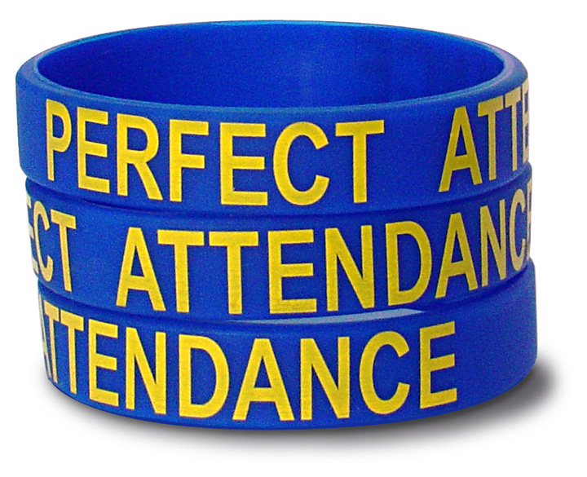
Advertising the AGM & notifying members
Notify members
check your constitution
includes families who have children enrolled for the following year
electronic means
Advertise
electronic newsletters for local paper, school or library
notice or banner at service
email to parents
around your community
personal invitations
any other means?
Element 7.1.2 Systems are in place to manage risk and enable
the effective management and operation of a quality service.
Notes:
Opening question
Ask people for any creative and successful methods they have used
Why did they attend the AGM last year?
Key messages
The more advertising the better to ensure you meet your quorum – could encourage families with young children who are thinking of enrolling in next couple of years – good marketing strategy
Discuss ways of getting people to attend e.g. providing enrolment info on the night, prize, interesting speaker
A personal invitation makes people feel welcome and is often hard to refuse

Slide 14

Recruiting new committee members
Notes:
Key messages
This is one of the biggest concerns of current committees.
Let’s look at one of the roles of the AGM subcommittee…….recruiting a new committee.
How participants were recruited?

Slide 15

Succession planning
  Is a ‘must have’ not a ‘nice to have’
Is a necessary part of any organisation's ability to:
  ensure continuity
  reduce risk
  improve staff morale
  preserve organisational memories
Element 7.1.2 Systems are in place to manage risk and enable
the effective management and operation of a quality service.
Notes:
Key messages
The success of any committee is enhanced by thoughtful succession planning, especially in the light of the high turn over of committee members. This is especially so If you are a sessional kindergarten or a committee that has a yearly term of office.
Succession planning is an important aspect of good governance to ensure continuity, reduce risk, improve staff morale in that staff feel secure despite the constant change and also to preserve organisational memories.
Committees have to be ready to deal with the changes. Leaving it all to the last minute can give you a CoM that lacks the necessary skills, motivation and knowledge to lead the organisation effectively.
We do acknowledge that this is becoming increasingly difficult but hopefully this presentation and the “Ending The Year on A High” self paced module will help you feel more confident and provide options.
So, how do we ensure that committee is operation from year to year and prevent a full committee turn over?
Some recruitment considerations include
Trying to ensure that the vice president is 3 year old etc..equal balance of 3 and 4 year olds
Establish sub committees to start involving families who may initially be afraid to commit but can see the valuable work the committee does ie. HR sub committee, Finance Subcommittee, AGM subcommittee, Fundraising Subcommittee
Consider the definition of membership in your constitution and reach out to local organisations EARLY.
Reaching out to members/ families who are incoming and aren’t involved in the service now – you have the enrolment details and can either include it in the enrolment form (would you like to volunteer?)
I think the placement suggests that good succession planning for the good of the organisation would mean taking the time to recruit the committee because of their role.

Slide 16
Recruitment considerations
When recruiting think about:
diversity of members – encourage continuity by recruiting parents from the upcoming 3-year-old groups
current members stepping into new role, eg. Vice President to President
approaching local community organisations
eligibility, longevity, useful skills
Element 7.1.2 Systems are in place to manage risk and enable
the effective management and operation of a quality service.
Notes:
Key messages
So, how do we ensure that committee is operation from year to year and prevent a full committee turn over?
Check constitution for rules around membership & who can be a committee member, in particular if you are approaching community organisations.
Some recruitment considerations include
Trying to ensure that the vice president is 3 year old etc..equal balance of 3 and 4 year olds
Establish sub committees to start involving families who may initially be afraid to commit but can see the valuable work the committee does ie. HR sub committee, Finance Subcommittee, AGM subcommittee, Fundraising Subcommittee
Consider the definition of membership in your constitution and reach out to local organisations EARLY.
Reaching out to members/ families who are incoming and aren’t involved in the service now – you have the enrolment details and can either include it in the enrolment form (would you like to volunteer?)
Nothing beats the personal approach when recruiting members. Approach potential committee members directly to discuss the roles and the process.
Current members can be re-elected which can provide continuity for organisation
In folder - Institute of Community Directors has a great 4 part Board Succession tip sheet in their tools and resources section which is very helpful. Also Governance Tip sheet developed by ELAA.

Slide 17


Committee Recruitment
Recruitment Pack…
the organisation's philosophy
a description of the management structure (Org. chart)
general roles and responsibilities for all committee positions
benefits to individuals, their children and their community
resources and list of support agencies
contact details of AGM sub committee
nomination process information and forms
Notes:
Key messages
Benefit of a recruitment pack - people more likely to agree if they know what is involved
Information to include in the recruitment packs can be found in the:
Early Childhood Management Manual (ECMM)
The recruitment pack could be either hard copy or electronic
Remember….. it is the committee’s task to recruit not staff, however staff can assist in the process by referring any parents to current committee members.

Slide 18

Successful recruitment strategies
Consider a social function for new parents for next year and have a brief presentation on the Committee of Management
Invite potential members to a committee meeting to get a feel for the role
Be prepared to answer questions and
provide information
Display enthusiasm and the personal approach
Element 7.1.2 Systems are in place to manage risk and enable
the effective management and operation of a quality service.
Notes:
Key messages
If inviting potential members to a committee meeting to get a feel of the role, ensure you discuss confidentiality with the potential members. Also potential members only stay for general business, they are required to leave prior to discussing confidential business.
Always be honest when answering questions from potential committee members.
Always have a recruitment pack (as previously discussed) ready to give to anyone who may be interested.
Pointing out the connection between fa
Emotional connection has changed with COVID – how do you engage and emotional connecting current families and NEW families (confidentiality and privacy)
Getting families excited to join the kinder and possibly a phone call once they RSVP to say thanks for RSVP, looking forward to meeting you

Slide 19
Skills we develop from the committee experience
Team Work – leadership, chairing, cooperation, delegation, conflict management
Organisational skills – planning, time management and keeping records
Decision making including handle complaints and ethical issues
Staff management
Financial management
Communication – report writing, presentations, using media
Understanding governance processes and legislation
Project management, including running fundraising events
Motivate others/Networking/Life long friendships
Notes:
Key messages
These are just a few of the skills and knowledge a committee member may develop when on a committee.
These skills are transferable as many parents can bring these already developed skills from their day jobs.
These points can be used when talking to prospective committee members to motivate them to nominate.
Any other skills or knowledge from your experience? Like developing knowledge of EC sector and building community engagement.

Slide 20
The nomination process
DO NOT wait until the night of the AGM
Consider
  the process to follow (via email, a box at the Kindergarten)
  a closing date ( 1 week or 24 hrs before the AGM)
Follow up with each person, before the AGM, if there is more than one nomination for a position
Remember, current committee members need to nominate if their term of office has ended
Should not be a competition– everyone on the committee has a role to play and everyone shares the responsibilities
Notes:
Key messages
Look at your constitution.
Historically, many people wait until the night of the AGM to nominate for a position.
To change the culture, you may wish to consider a closing date. This is encouraged process for running online AGM.
If more than one person nominates for a position, consider speaking to each person before the AGM to see if this is the only position they would consider.

Slide 21

Reporting

Slide 22
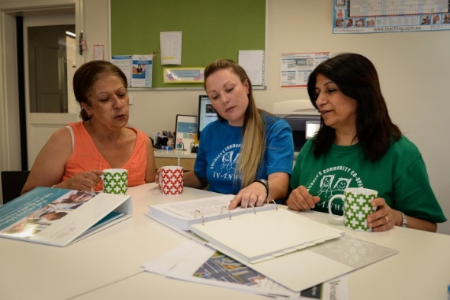
What reports do we need?
Financial Report (Mandatory): Including an audited report where required
Committee: What the committee has achieved, ongoing projects, brief update on current QIP, thanks to outgoing members
Staff: Highlights of the year, brief update on educational program, remote learning and how the children have progressed through the year
Others: May include Fundraising, Maintenance etc
Notes:
Key messages
The Financial Report is a requirement of a incorporated association. This is the minimum requirement however, other reports are usually presented at the AGM.
The committee report may be prepared by the President or Secretary.
Staff reports may be one report with information on each group or individual reports from each group.
Reports should be comprehensive, succinct, interesting and/or creative . People soon switch off if one person talks for too long or the report is uninteresting.
You may like to consider some creative ways to present your reports e.g. powerpoint, video etc.
copies of the reports should be emailed to the members in advance. In this case, speakers may chooses to just highlight a couple of things and answer any questions rather than reading out what people have in front of them.
Remember…….all reports should be formally adopted (moved, seconded and put to the vote) at the meeting.
The committee can also determine if there are other reports that should be presented at the AGM such as fundraising, any large project or put everything in the President’s report as the president reports on behalf of the whole committee.

Slide 23
Financial reporting
As soon as possible after the end of the financial year, ensure financial statements are prepared
Financial statements must include:
    Profit and loss statement for the financial year
    Balance sheet (assets and liabilities)
    Any mortgages, charges and securities affecting any property of the association
    Information about any trusts affecting the association
Completed statements must be presented to the committee and certified by two committee members that they give ‘a true and fair’ view of the association’s financial position, prior to the AGM
This certified report is then presented to members at the AGM
Notes:
Key messages
Financial Reporting
Profit and Loss Statement – what has happened over a period of time.
Balance Sheet – snapshot of finances at this point in time.
Both reports provide a comprehensive view of the financial position.
May be required to undertake an annual audit - specified in their constitution, service agreement or as part of comprehensive and transparent financial practices.
As part of the Service Agreement Compliance Certification (SACC) , you may be required to submit an audited statement with Financial Accountability Report (FAR) to DET, audit must cover full financial year, be prepared by independent qualified accountant registered as company auditor and member of Australian Society of Certified Practising Accountants or Institute of Chartered Accountants. Can’t be prepared by member or employee of association.
If COVID19 mades it difficult to engage an independent accountant or auditor to review your financial statements, you may request an extension. Complete our Extension of time to hold an AGM or lodge financial statements form (Word, 97 KB) and send it to cav.registration@justice.vic.gov.au.
In Folder – financial report checklist and submission of financial statements form and form to apply for extension of submission

Slide 24
Auditing requirements for Incorporated Associations
Three tiered reporting framework based on association’s total income:
Tier one - less than $250,000 – no additional reporting requirements outside of your constitution
Tier two: $250,000 - $1,000,000 – must have accounts reviewed by an independent accountant. Accountants report must be presented to the AGM
Tier three: More than $1,000,000 – accounts must be audited by an independent auditor
Notes:
Key messages
The information on this slide is taken from Consumer Affairs
Some services do a full audit, even if not required, as part of a comprehensive and transparent process. This is considered Best Practice.
If you do a full audit then the following applies.
Key messages for Tier Three Full Audit Appointment
Financial audit must be done by:
a registered company auditor or firm
a member of, and holds a current practicing certificate from CPA Australia or the Institute of Chartered Accountants in Australia, or
someone approved by the Registrar of Incorporated Associations for this purpose.
Must not be
A member of the associations committee
An employer or an employee of a member of the committee
A member of the same partnership as a member of the committee
An employee of the association
In folder – Financial statements and auditing requirements

Slide 25
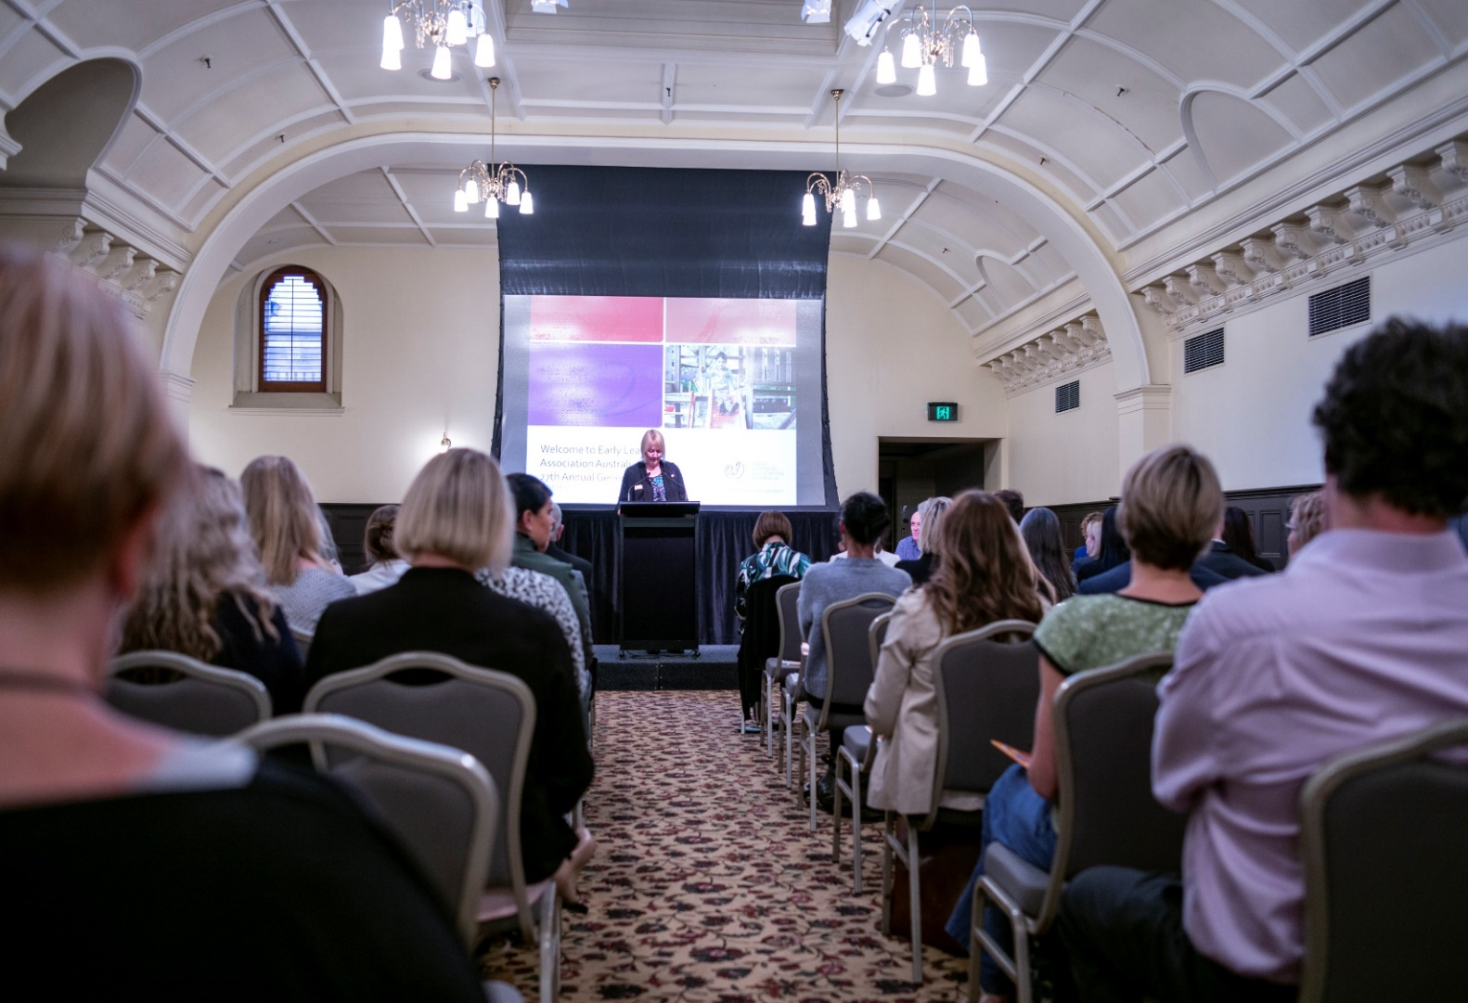
The Annual General Meeting (AGM)
Notes:
Half way point – Answer any questions from chat
5 min Break
Key messages
Treat the AGM as if you were hosting an event in your home.
Be Prepared
Be welcoming
Ensure you have at least 1 or 2 Committee members coordinating IT support
Ensure you have all the required resources ready e.g. attendance list for voting members and have spare nomination forms
know who your guests and VIPS are

Slide 26

Agenda
Venue:
Date: Time:
Opening and welcome
Apologies/attendance list circulated
Confirmation of minutes of last Annual General Meeting and of any Special General Meeting held since that meeting
Business arising from the minutes
Presentation of reports
      President
      Treasurer/Auditor
      Teacher/coordinator
Special business
Business may be conducted if advertised according to the constitution, for example, amalgamation with another service, etc.
Guest speaker / information session for new parents (optional)
Election of new committee
(chaired by…………………………)
Close meeting
Notes:
Key messages
The agenda should include:
starting time, date and place
welcome and apologies
confirmation of minutes from the last AGM
list of reports to be presented
guest speaker and topic of presentation
election of new committee
Must have a minutes from the previous AGM.
Must have a committee member from the previous year to formally move the confirmation of the previous AGM minutes.
When conducting online meeting, consider muting participants, sharing your screen to view agenda and reports etc. Also have 1 or 2 people providing IT support during meeting, can also be looking at live chat feature.
Folder
A Sample Agenda is included in the folder and is also available in the Early Childhood Management Manual (ECMM).

Slide 27
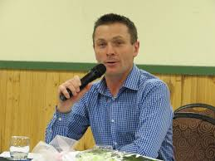
Election of new committee
Election process is determined by your constitution
Recommend a returning officer presides over the election process
All positions declared vacant
All members of the association are eligible for election
Element 7.1.2 Systems are in place to manage risk and enable
the effective management and operation of a quality service.
Notes:
Key messages
Check your constitution for rules and process. For example Eligibility for committee - who can be a member of the association
To demonstrate transparency, the President vacates the chair and all positions are declared vacant (best practice but not in ACT)
An independent chairperson takes over the chair. Independent chair is also known as the Returning Officer (Could be guest speaker, local school principal, local councillor, past president)
Proxy voting: guidelines will be outlined in your centre’s constitution
The new committee
The committee are the association members that have been elected.
They will be responsible for making the decisions on behalf of the Kindergarten.

Slide 28
Possible election scenarios
Single nominations are received for all positions prior to the meeting
Nominations are received for only some of the positions (or none at all) prior to the meeting
More than one nomination is received for a position
Notes:
Key messages
Always refer to your constitution and follow the process outlined in the constitution.
Make sure you are familiar with your constitution and have it on hand at the AGM as a reference, if needed.
There are no rules about the order that positions are filled. Generally, the President is first but it doesn’t have to be.
If position is not filled, you can move on to the next position.
3 Possible election scenarios:
Nominations have been received for all positions prior to the meeting:
Nominations read out
All positions are declared filled
This is best case scenario if running online AGM.
Or Nominations have been received for some positions prior to the meeting:
Those positions are declared filled (no further nominations for those positions)
Nominations accepted from the floor for remaining positions (Constitution may outline certain requirements for the acceptance of nominations from the floor)
Move, second and accept all nominations
Or More than one nomination is received for a position
A vote will need to be taken
Determine by show of hands or secret ballot
May be helpful for each of the nominees to introduce themselves so that people can make an informed decision
Any nominations taken from the floor or any voting been conducted could be indicated by using the “raise hand” icon with the online platform.
To clarify the voting process: A person makes a motion to do something and put it up for a group vote (move), If another person ‘seconds’ the motion they are indicating that they also wish the motion to be considered via a vote. If the motion is accepted it may then be debated, voted on, and if agreed, carried (accepted).
All nominations should be recorded in the minutes as moved, seconded and the result of the vote.

Slide 29

Unfilled positions
It is not essential to fill all committee positions at the AGM; the service can continue functioning provided enough committee members have been elected to enable decision making (i.e. a quorum)
14 days after vacancy arises, Secretary role must be filled. This is a requirement under the Act.
Committee need to continue advertising and recruiting to fill those positions as per the casual vacancy clause in your constitution
Element 7.1.2 Systems are in place to manage risk and enable
the effective management and operation of a quality service.
Notes:
Key messages - Associations Incorporation Reform Act 2012
73 Filling Secretary vacancy
(1) Subject to subsection (2), if the office of the
secretary of an incorporated association becomes
vacant, the association must, within 14 days after
the vacancy arises, fill the vacancy in accordance
with the procedure provided in its rules.
Unfilled vacancies
If all positions are not filled at the AGM but sufficient members have been elected for a quorum for committee meetings, the committee can continue to meet and make decisions.
Vacancies can be filled by the Committee
The constitution usually says:
“In the event of a casual vacancy occurring during the year, The Committee shall have the power to appoint a new member from the members of the Association.”
No need to drag the process out unnecessarily.
However, with planning and preparation, hopefully you would have recruited fully before the AGM itself.
Also, if this scenario occurs consistently across a few years, do you want to consider reviewing the committee size as per the consitutuion
74 Notice of appointment
(1) The secretary of an incorporated association must,
within 14 days after being appointed, give written
notice to the Registrar of his or her appointment.
Penalty: 5 penalty units.
(2) The notice must be in the approved form and
include the following—
(a) the secretary's full name and address;
(b) the prescribed particulars.

Slide 30

At the end of the meeting
Distribute
  forms that need to be completed asap
  contact list of new and old committee members
Set date of handover meeting (for new and current committee members)
  prior to date set out in constitution under Section 49 Term of office or
  within one week of the AGM
Notes:
Key messages
Historically, the newly elected committee is responsible for the management of the centre from the date they are elected and are therefore the decision makers.
Committees should refer to their constitution, under Section 49 Term of office to confirm if this is still the case for your committee or if there is a specific date stated in the constitution when the newly elected committee takes office. A date is often stated to ensure that all appropriate approvals, required to legally run the service, have been obtained.
The Handover meeting date should be set within a week of the AGM if there is no specific date for the new committee to take over.
The outgoing committee may still need to be available for support after the Handover meeting.

Slide 31

Forms or notifications to be completed
myGovID – set up Relationship Authorised Manager (RAM) via Business Portal
Consumer Affairs - Change of association details via myCAV
ACNC - Responsible Person Change via the Charity Register on website
Bank accounts - Change of authorised signatories
DET/ACECQA:
PA08:Notification of change to
information about approved provider
PA02:Declaration of fitness and propriety
  (including Police records check forms/WWCC forms)
Notes:
Key messages
The AGM subcommittee can collate the necessary forms that will be given out at the end of the AGM. Where possible, do not wait until the handover meeting to complete these forms.
Appropriate forms or notifications need to be completed to ensure incoming committee fulfils their legal obligations and business continuity.
myGovID replaced AUSKEY from 1/04/2020. Go to www.mygovid.gov.au for information about setting up.
Consumer Affairs - If new Secretary has been elected at the AGM, the outgoing secretary must complete and submit a Change of Association Details form within 28 days.
Treasurer to check with bank regarding the documentation they require to enable a change in signatories. Ensure that unauthorised (or old signatories) are removed.
In most cases evidence of authorisation such as minutes of the meeting and identification will be required. If the person already has an account with that institution they may not be required to provide identification.
ACNC - change via the website.
DET/ACECQA (within 14 days of AGM)
For each new person with management or control (the executive) the following documents will need to be uploaded on the ACECQA website via NQA IT system:
PA08 Notification of change to information about approved provider
PA02 Declaration of fitness and propriety form – Paper form to be completed and uploaded.
A criminal history record check issued not more than 6 months before the date of the declaration
A current Working with Children’s Check or VIT Registration and
Evidence of identity (current passport or drivers licence).
In Folder – PA02 form and Committee Basics for full list of notifications

Slide 32
After the AGM
Minutes:
Write up minutes as soon as possible and file with copies of reports and attendance sheets. This file should be passed on to the new committee.
ACNC:
Incorporated associations that are a registered charity with the ACNC must submit their annual statement t0 ACNC.
Consumer Affairs Vic :
Incorporated associations that are not a registered charity must submit their financial statements to CAV via MyCav within 1 month of their AGM.
Notes:
Key messages
Minutes are an official record of what took place at the AGM. The secretary should:
type the minutes and stored in a safe place to have confirmed at the next AGM and
give a copy of the minutes to the new secretary at the handover meeting.
In folder – Reporting annually to the ACNC and Regulations of Charities in Victoria
Application form for extension

Slide 33
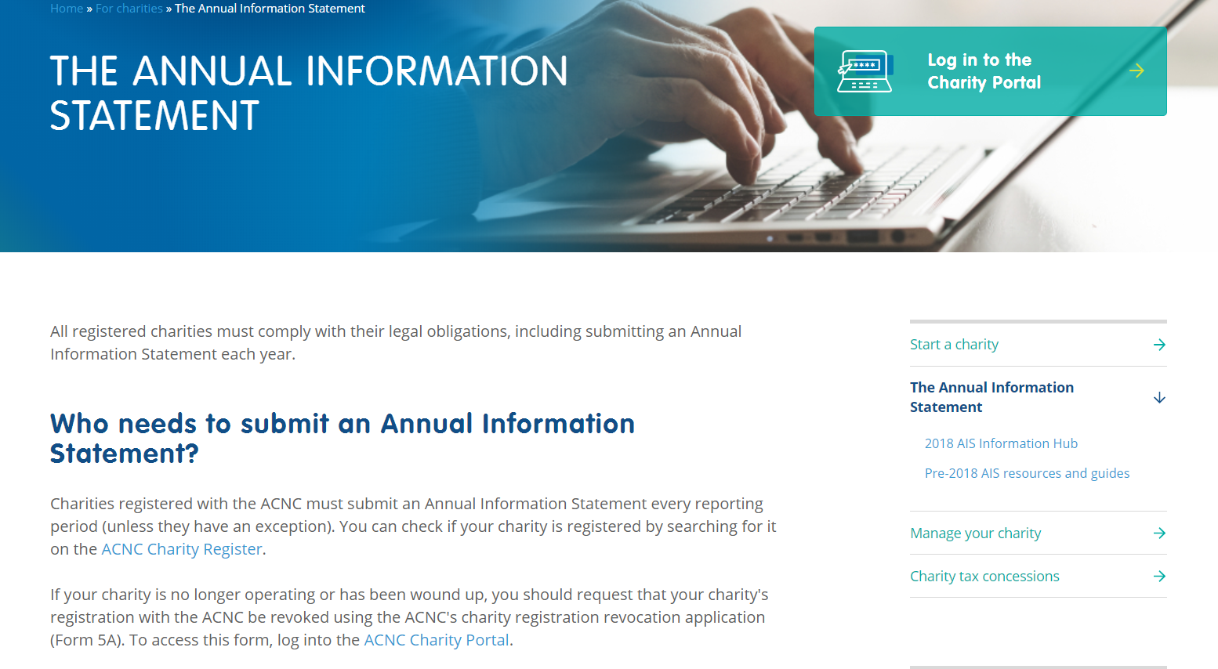
Australian Charities and Not-for-profit Commission (ACNC)
Notes:
Key messages
Registered charities must report each year to the ACNC
Reporting requirements will vary depending on the size of the charity, as previously discussed.
Folder
See several handouts in the folder and www.acna.gov.au has further information and fact sheets
Background
ACNC - Australian Charities and Not-for-profit Commission
The ACNC commenced operation on 3 December 2012
Kindergartens endorsed as charities with the ATO were automatically registered with the ACNC www.acnc.gov.au
To check if your service is a registered Charity go to www.acnc.gov.au
As a registered charity you must:
Abide by governance standards
Notify ACNC of changes
Keep records
Report to ACNC each year

Slide 34

After the AGM
Local government:
Lease/service agreements may require a copy of the financial statement and minutes from the AGM; contact details of new committee.
Send thank you notes to guests
Notes:
Now I will pass on to my colleague Katrina will cover the second part of this presentation, which is what occurs after you have held your AGM.

Slide 35

Handing over
Refer to the constitution on when the new committee becomes responsible as this may be as soon as the election is over or at a specific date.
AGM sub-committee may organise necessary documents at the same time as arranging AGM.
Notes:
POLL : How was your handover experience?
Key messages
Make sure to check the Term of Office details in your constitution as this may vary. For some it will be straight after the AGM, for others it may be at the commencement of the new year.
To ensure continuity of governance, it is important that there is a comprehensive and well planned handover from the outgoing committee.
A few members of the outgoing committee may also offer to continue working alongside the new committee for a short period of time as mentors.
The success of any committee is enhanced by an effective handover of knowledge, skills and tasks from the previous committee.
Ideally, planning must commence well before both the AGM and the handover meeting. This includes gathering documents that need to be signed. The required documents will be discussed shortly.
What worked well and what could be improved during your handover experience?

Slide 36
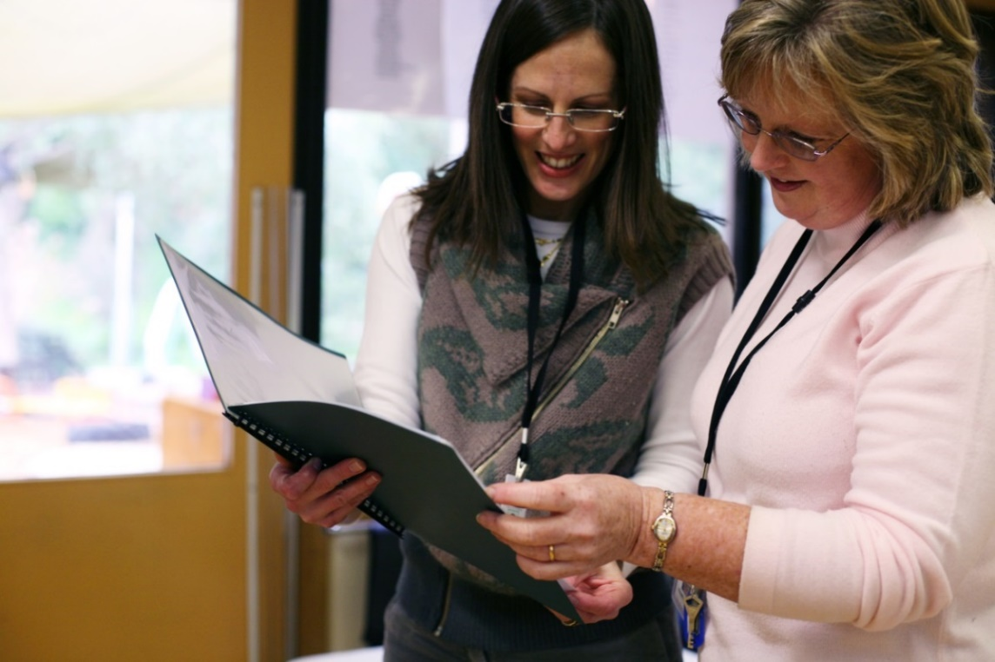
One-to-one handover
Have 1:1 time for each previous office holder to meet and hand over information to their successor
Element 7.1.3 Roles and responsibilities are clearly defined,
understood and support effective decision making & operation of the service.
Notes:
Key messages
Have a 1:1 time for individuals to hand over specific position information.
Outgoing committee members may act as a mentor or be available as a sounding board, if required.
Will this occur with break out rooms or another meeting at another time

Slide 37
Handover meeting
Attendees - outgoing & new committee members
Purpose – information meeting to
discuss/share information and
complete forms.
Time – within one week of AGM or prior to date set out in constitution under Section 49 Term of office
Consider running an online meeting
Element 7.1.3 Roles and responsibilities are clearly defined,
understood and support effective decision making & operation of the service.
Notes:
Key messages
It is important that all members of the outgoing committee attend the handover meeting to ensure that the incoming committee members feel welcomed.
All new committee members should attend the handover meeting as it provides them with an opportunity to:
experience and understand how committee meetings are operated
seek clarification on any aspect of the business
discuss relevant matters.
Consider outgoing committee members make themselves available for a period after the handover to provide any clarification on decisions or processes. THis is recommended until the new year commences.

Slide 38

Handover meeting agenda
Introduce all members and distribute folder
General discussion about the role of the committee as:
      Manager of the service (subcommittees, policies, planning, funding)
      Approved Provider (where applicable – legal responsibilities, Quality Improvement Plan)
      Employer (where applicable – staffing arrangements, award, conditions, any specific issues such as Workcover)
  Role of the early years manager (where applicable)
Conducting meetings
Decision making
Confidentiality
Future planning including the proposed 2023 timetable
Notes:
Key messages
An agenda will ensure that discussion is kept to the topics and all necessary items are covered.
The outgoing President can act as chair and demonstrate meeting procedures.
Don’t forget the basic housekeeping such as – location of files and resources, keys, light switches, alarm systems, ELAA membership number.
It is important for committees to also look beyond their term of office to ensure the sustainability and improvement of the centre.
This may include passing on information about:
Are your current and future users happy or are there things you need to review
Is your budget viable, what plans do you have in place if there is a sudden decrease in income
Is the program meeting the needs of your community, are you making the best use of your resources.
Has your committee found this year particularly difficult or options for a new committee limited, have you considered Early Years Management, is it time to reconsider that option?
Are you aware of the VECTEA and the new agreement.
Are you aware of the NQF and assessment and rating process – have you started, make sure you hand over any information you have and also any documentation you have started especially in relation to your QIP
Has your committee put any long term plans into place e.g. playground redevelopment, what are they, is there a budget, are there options to meet any changes which may occur

Slide 39

Committee information folder
Important documents e.g. Constitution
Committee and Service’s policies and procedures, code of conduct
https://jobs.earlychildhood.education.vic.gov.au/
Detailed roles of the committee and its members
  If your centre is part of an early year's manager, information regarding the early years manager should be included (contacts, responsibilities etc.)
  Roles will depend on your constitution – a OH&S officer is very important
Financial reports and a copy of the budget
Minutes of previous meeting
Committee contact details
Kindergarten timetable and programs offered
Staff rosters, positions and hours of employment
Notes:
Key messages
A committee folder or handbook will be helpful to new committee members- this may be via a cloud based program such as onedrive, sharepoint or paper version
It is helpful for the smooth operation of the committee if all committee members have access to and knowledge of critical documents.
A shared knowledge of these documents allows for more informed committee communication and functioning.
The ELAA Early Childhood Management Manual contains a comprehensive list of suggested material to include in the folder or handbook.
The points on these two slide are a starting point.
If you are not the employer or approved provider some of the information may not be required.
Where is specific information kept at the centre? Who has authorisation to access the information?
Some documents such as the
Relevant legislation
Constitution
Service policies could be provided on a USB
Other information which should be included are: minutes, action sheets, budget/financial reports, program timetable, contact details, staff rosters, roles and responsibilities, meeting dates,
It is also recommended to have kinder based emails so new committee have access to the past and not be required to re-invent
In folder – Handover checklist

Slide 40
Committee information folder (continued)
  Insurance cover (VMIA & Contents insurance providers)
  National Quality Framework (self-assessment and quality improvement plan)
  List of resources and support agencies
    ELAA membership information
    ELAA PolicyWorks
    ELAA Early Childhood Management Manual (ECMM)
    DET Kindergarten Funding Guide
    Membership and password register
Notes:
In folder – Link to VMIA Kinder Quick reference guide and VMIA website as well as list of important legislation and support agencies

Slide 41
Succession Planning
A part of a successful handover is to have a succession plan in place to ensure the long-term success of the organisation.
Taking into consideration workforce, finances, program model and timetables, infrastructure.
2022 Committee Meeting Summary
Month of the year | Key considerations | Details
December 2021 | Appointed 2 new ECTs | - Employment details (ie fixed term contract)
February | Discussion on building expansion | - 2022 committee research design quote throughout 2022
March | 2023 3Year old Flexible funding policy introduced | - DET released this policy to be enacted in 2023-2024
April
Notes:
A through handover will ensure that the organisation will continue to operate with minimal disruptions or change when a new committee commences. This will also ensure that any projects, goals etc will continue.
One strategy to assist with the handover is to develop a summary of any key achievements, projects or considerations. This slide shows an example on how to do this.
It will be a 1-2 page document and is a guide to where committee can provide further information in the minutes. This is very useful for committees that are searching for information about something that occurred a few years ago.
The secretary would complete this each month.
For example
- in December 2021 there was the appointment of ECTs – this information is important to the new committee as they will be required to conduct probation meetings, appoint permanently
- Feb- Building expansion
What preparation is involved and the handover will be a summary of how this research has done. And note the date of the com meeting with the minutes

Slide 42

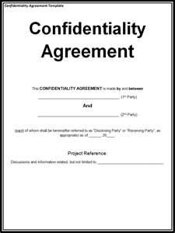
Reinforce confidentiality
All committee members should sign a code of
conduct /confidentiality agreement at handover
A duty, to do their job to the best of their ability, to maintain confidence at all times – car park, social events, school, in the community
Confidentiality relates to all information
about parents, staff, other committee
members, external members of the
community that may be linked to the service.
Element 7.1.3 Roles and responsibilities are clearly defined,
understood and support effective decision making & operation of the service.
Notes:
Sample Committee Declaration in folder.

Slide 43
What should the new committee do now?
Become familiar with service documents:
  Constitution
  Current policies and practices. (Set up subcommittees for staffing, complaints and grievances)
  Budget
  National Law and Regulations
  National Quality Standards, Rating and Assessment and Quality Improvement Plan (QIP)
  Committee office information – filing, staff information
  Child Safe Standards
  ELAA membership number, services, resources and training – check ELAA website and signup for ELAAvate
Notes:
Key messages
New committee members should become familiar with as many documents, as possible, in preparation for their first committee meeting.

Slide 44
The new committee’s first meeting
If the AGM has been held in November, the next committee meeting is usually held in December.
It is recommended that both the new and exiting committee attend.
Element 7.1.3 Roles and responsibilities are clearly defined,
understood and support effective decision making & operation of the service.
Notes:
Key messages
Refer to your constitution to ensure you hold your first meeting of the incoming committee by the required time.
In the absence of a specific provision, it is normal practice of have a meeting within 4 – 6 weeks of the AGM.
Meeting should be used to undertake any important outstanding business from the previous committee

Slide 45
Useful links
Consumer Affairs www.consumer.vic.gov.au
Australian Charities Not-for-profit Commission www.acnc.gov.au
Institute of Community Directors Australia www.communitydirectors.com.au
Justice Connect Not-for-profit Law Hub www.nfplaw.org.au
Commission for Children and Young People ccyp.vic.gov.au
Victorian Institute of Teaching www.vit.vic.edu.au
OHS in Services ohsinecservices.org.au
Department of Education and Training www.education.vic.gov.au/childhood/providers/regulations
Email: licensed.childrens.services@edumail.vic.gov.au
Phone: 1300 307 415
Australian Children’s Education and Care Quality Authority (ACECQA)
www.acecqa.gov.au
Notes:
Folder - A list of these and other useful weblinks and governance resources is included in the folder.

Slide 46
Resources available on the ELAA website
Resources available ELAA Early Childhood Management Manual (ECMM) Policy Works Manual - NQF Employee Management and Development Resource Managing Performance-Related Concerns Budget Works Model Works | For ELAA members Industrial bulletins Wages bulletins Agreements and Awards Member Forums Pro-rata Annual Leave calculations Portable Long Service Leave calculations Work history calculations Sample constitution COVID19 FAQs and resources
Free Governance training (Live webinars & Self-Paced) Starting from the Beginning – Governance Information Starting From The Beginning – Employee Management Financial Management Employee Management and Development Resource Ending The Year On a High – Planning your successful AGM | Consultancy service HR, IR, Governance, OHS consultants to provide tailored projects and training.
Notes:
Key Messages
Member services team is a small one and we field about 500 emails/calls every week. We endeavor to provide holistic support to our members which includes the development of variety of resources to support and enable you to be successful in your roles.
Early Childhood Management Manual / PolicyWorks
ECMM v3 – Updated 2019 is now available for purchase
Policy Works currently being reviewed and minor adjustments to regulations are being updated
Information on the ELAA website under ‘Shop Resources’. Good discount on manuals for members.
Budget Works and Model Works
soon to be released – will assist services of different sizes and make up with the planning and implementation of timetable design/delivery and staffing and budgeting of delivering programs.
Webinars
Committee as an employer
Financial management
Occupational health and safety in early learning services
Budget and fees
Incorporated associations: Roles and responsibilities for committees of management
Employee Management in a Crisis
Training
Variety of sessions to assist COM with understanding the roles and responsibilities that come with managing an early childhood education and care service
Consultancy service
ELAA understands some responsibilities or tasks can be difficult, COM may not have the skills or time to conduct. Consultancy service can used for such situations at a cost. Visit website for more information and to complete the request form and scoping fee.
ELAA’s renewal period is upon us – if you’re an ELAA member, we encourage you get onto the renewal as soon as possible!!

Slide 47
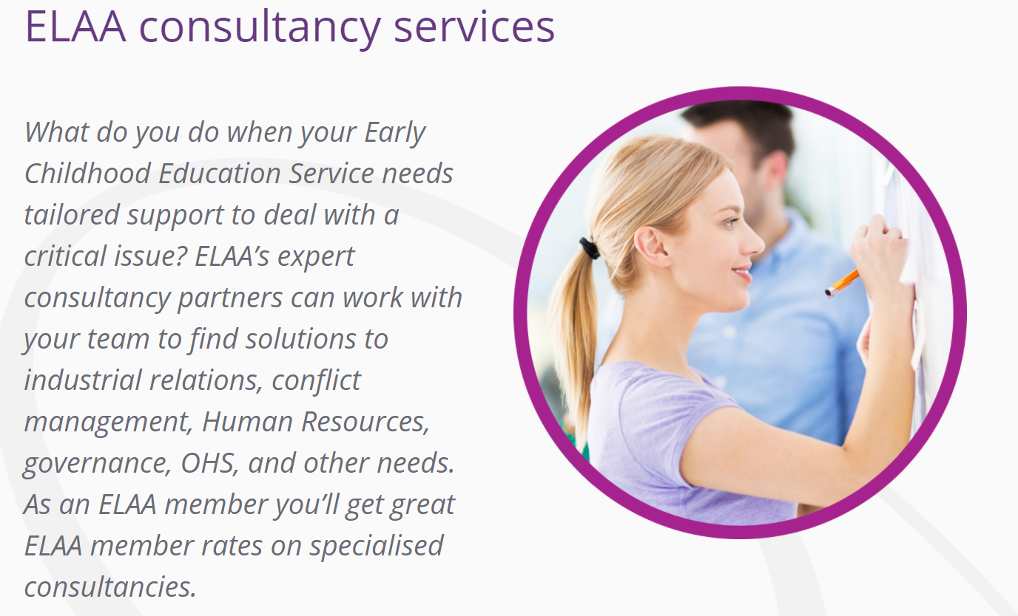
For more information on ELAA’s consultancy service, please visit our website or contact us via training@elaa.org.au

Slide 48

Professional Development with ELAA:
Term 3 Free Live Webinar Governance Training open for registrations now.
- Financial Management
-Employee Management and Development Resource live webinar
- Ending The Year on A High
https://elaa.org.au/learningbrought2life/program/
Self-paced online learning modules can be accessed at any time and cover a range of governance related topics.
All committee members should be encouraged to complete these.
Notes:
Please register on our website if you are interested in attending
ELAAvate will also remind members of upcoming events
Self paced modules can also be accessed on our website and of course in 2022, free training opportunities continue each term and new LB2L sessions will be scheduled.

Slide 49
More information
 www.elaa.org.au
membersolutions@elaa.org.au
(03) 9489 3500
(Press 1 for Education/Governance and press 2 for Workplace Relations)
Subscribe to ELAAvate for news that comes to your Inbox every fortnight
Notes:
Key Messages
The hours for accessing phone service is from 10am -3pm
The ELAA website provides a range of information, including free resources, professional development and training information.
If you subscribe from the ELAA home page you can nominate an email address that suits you. If you log in using your member number and subscribe from your service page, e-News will be sent to the service email address.

Slide 50

Thank you for attending!
Please remember to complete your evaluation form.
Your resource pack will be emailed to you after today.
Notes:
Key messages
If time permits answer any questions not yet covered?
You will be directed to the evaluation form once you leave this webinar. Please spend a few minutes to provide us your feedback as it is extremely valuable.
Thank participants.

